Slide 1
Educational, Healthcare, and Military Spending A Data Visualization
Daria Chylak
DATS 6401 Visualization individual project
Tuesday, October 15, 2019

Slide 2
Summary
Data visualization – analysis of various spending for G-20 countries
Educational, Healthcare, and Military
Using Google API tools
Data came from World bank open data website (data.worldbank.org)
Range of five Years analyzed – 2011, 2012, 2013, 2014, 2015
Countries analyzed – Top 10 G-20 countries

Slide 3
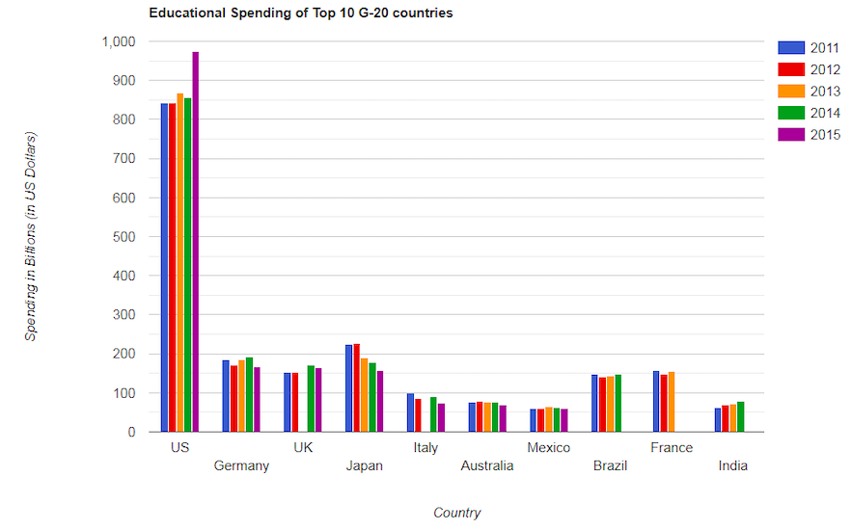
Educational spending of Top 10 G-20 countries
Note: UK, Italy, Brazil, France and India are missing data.

Slide 4
Healthcare spending of Top 10 G-20 countries

Slide 5
Military spending of Top 10 G-20 countries

Slide 6
GDP Comparison of G-20 countries

Slide 7
GDP versus Spending

Slide 8
Education spending versus Military Spending

Slide 9
Per Person Educational Spending versus Per Person GDP

Slide 10
Fastest Growing Countries in Healthcare and Educational Spending (Fixed Value)

Slide 11
Fastest Growing Countries in Healthcare and Educational Spending (Percentage)

Slide 12
Relationships and Trends
From 2011 to 2015, the United States spent the most (by a large margin) on Healthcare, Educational, and Military spending
In 2011, The United States spent slightly more on educational spending versus military expenditures, while all other countries analyzed spent much more on education that year (compared to what they spent on military spending)
The fastest growing country in healthcare and educaitonal spending (fixed value) is the United States
The fastest growing country in healthcare spending (percentage) is Brazil, and the fastest growing in educational spending (percentage) is Brazil

